Slide 1
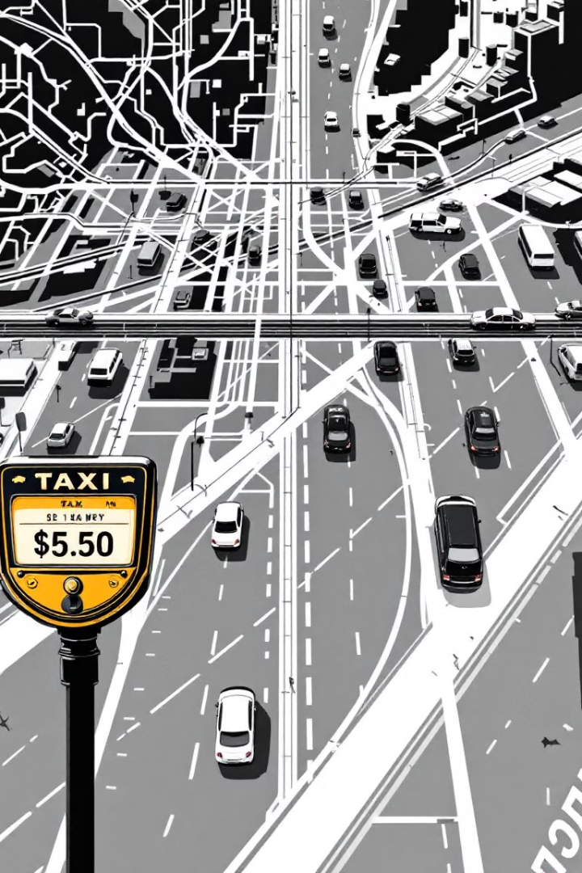
Ride Fare Prediction using Machine Learning
Presented by muhammed mufeed cp 07/04/2025

Slide 2
Introduction
🧠 problem
Predicting fare based on ride details.
🌍 Why is it important?
Helps ride-hailing companies set competitive and fare pricing strategies
Assists drivers in estimating potential earnings for different trips.
Improves customer experience by providing fare estimates before booking.

Slide 3
Objectives
🎯 Project Goals
Predict fare amounts using machine learning algorithms.
Compare performance of multiple regression models.
Analyze ride booking data to identify featurs affecting fare prices
Build a regression model to predict fare amounts
Build an intractive dashboard for Better dicision making.

Slide 4
Dataset
🗂️ Source
Kaggle – Ride Fare Prediction Dataset
📊 Size
2 lakh rows
🗺️ Features
pickup_latitude, pickup_longitude
dropoff_latitude, dropoff_longitude
distance_km (engineered using the Haversine formula)
pickup_datetime
hour, day, month, year
day_of_week, is_weekend, is_night, is_rush_hour
fare_amount(target variable)

Slide 5
Methodology
Data Cleaning
Removed nulls, duplicates
Feature Engineering
Calculated distance using pickup & drop-off coordinates.
Extracted date/time features (hour, day, weekday).
Data Visualization
Analyzed trends using graphs and heatmaps.
Model Building
Used algorithms
Evaluation
Compared models using RMSE and R² scores.

Slide 6
Algorithems
Linear Regression – As a baseline model
Random Forest Regressor – Captures nonlinear relationships and reduces overfitting
XGBoost Regressor – High-performance boosting algorithm for improved accuracy

Slide 7
Evaluation & Results
Model
RMSE
R² Score
Linear Regression
8.12
0.72
Random Forest
5.40
0.87
XGBoost
5.20
0.89

Slide 8
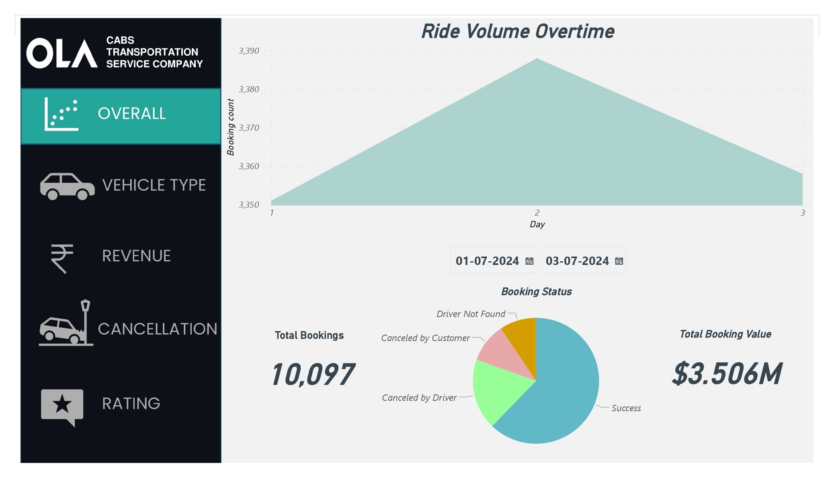

Slide 9
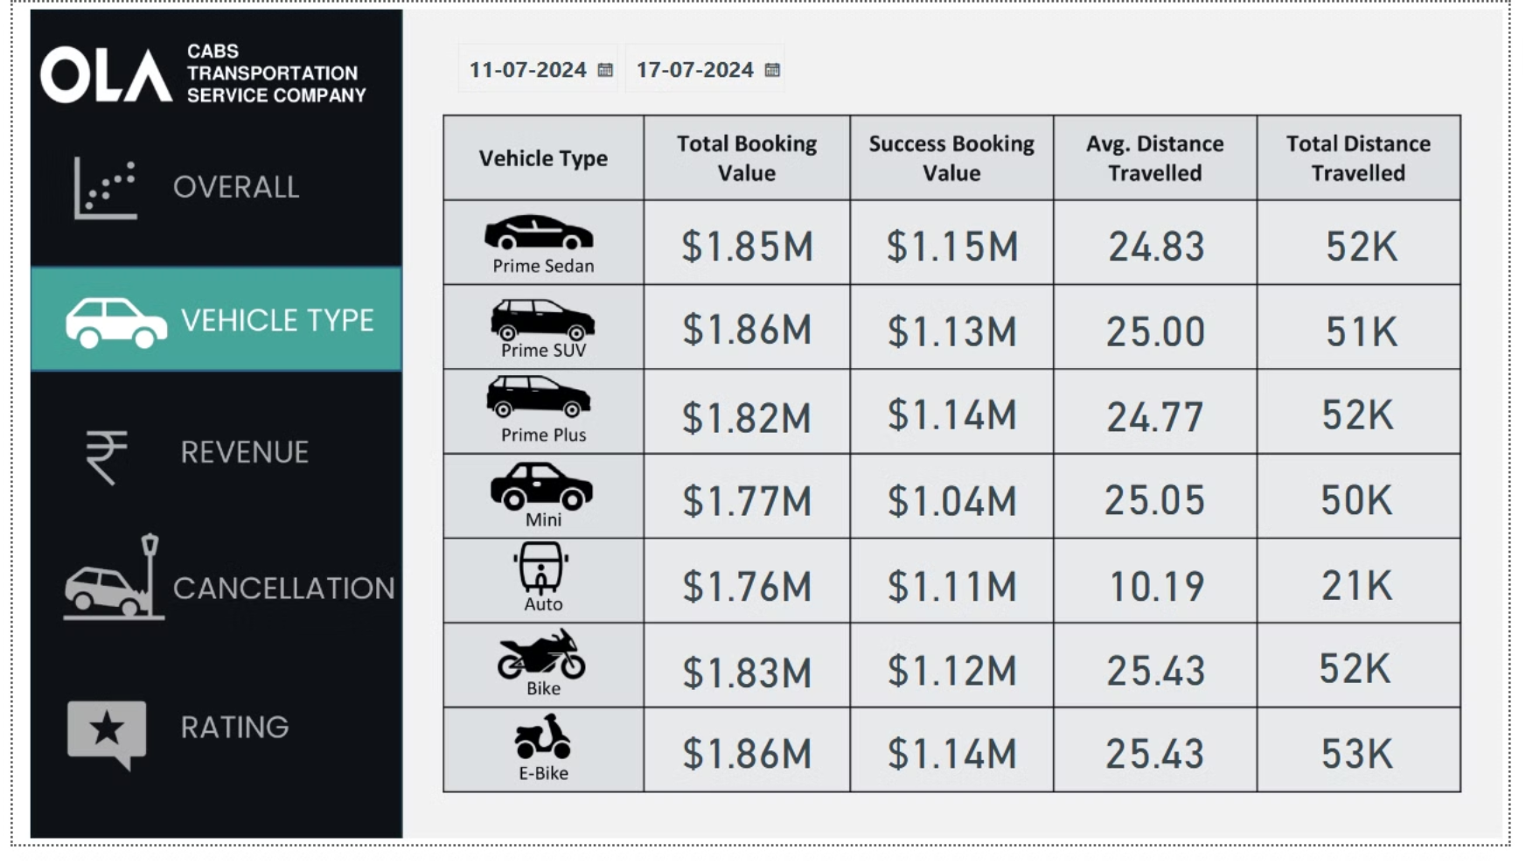

Slide 10
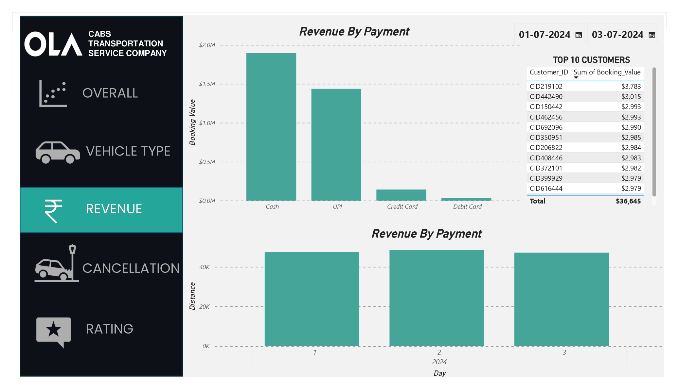

Slide 11
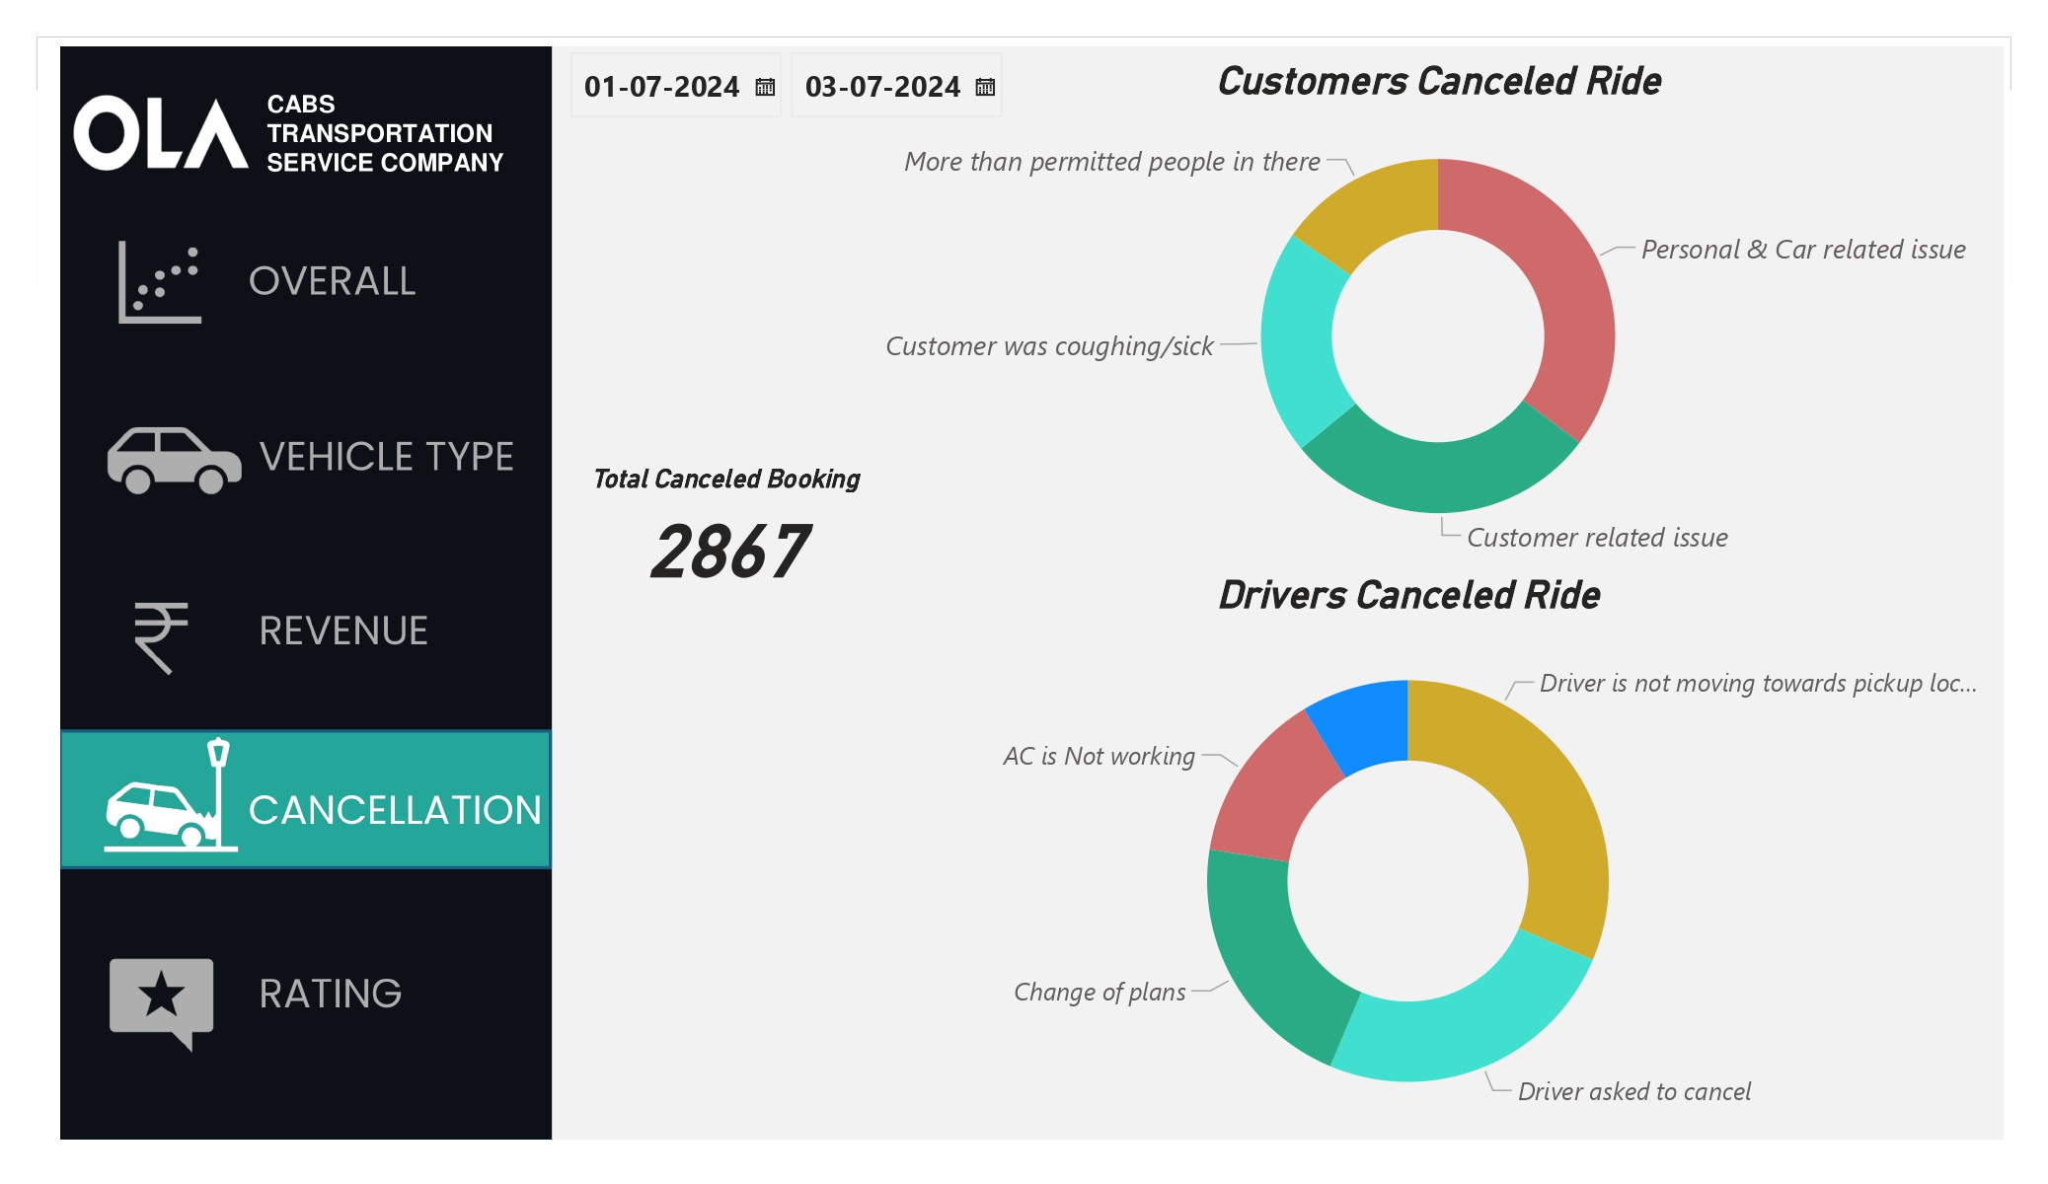

Slide 12
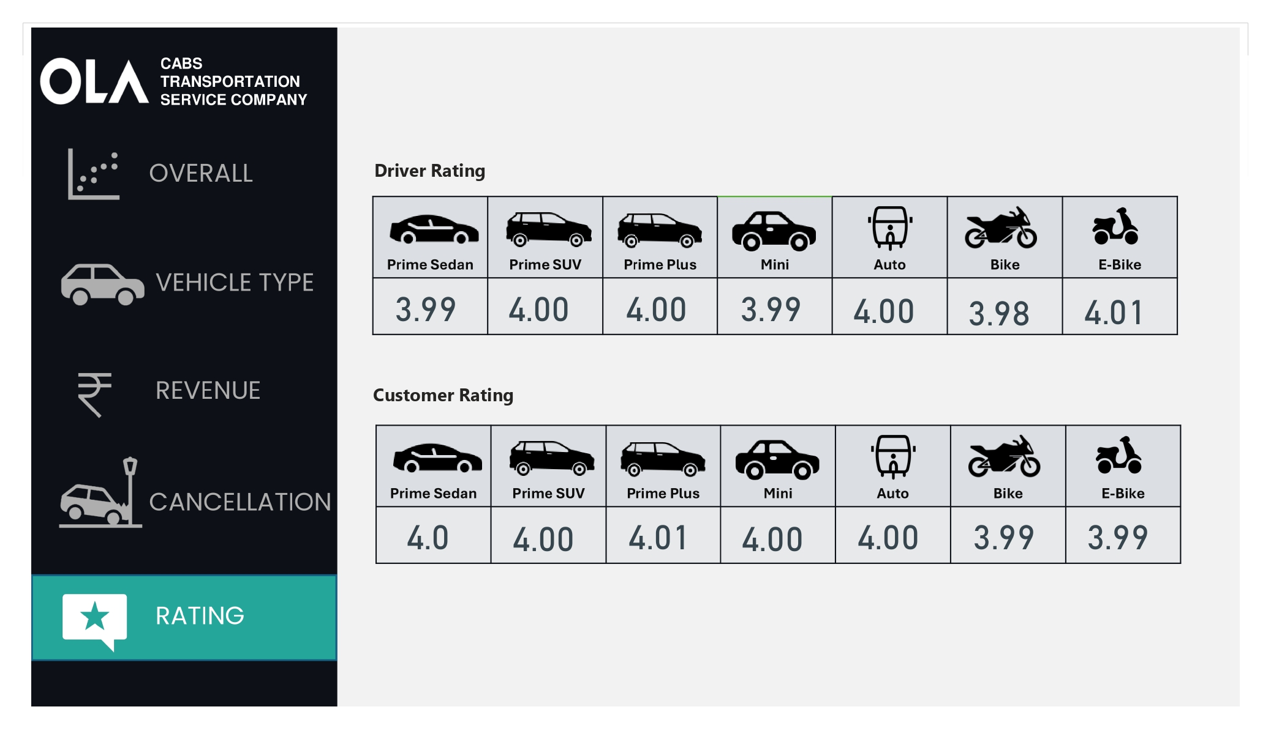

Slide 13
Thank you

